Slide 1

Lecture 4 Functional Programming
Distributed Systems
Semester 1 2022/2023
Dr. Ayman Khallel Ibrahim

Slide 2
Content
What is functional programming
Functional programming languages
Features and concepts
Examples
Advantages
Limitations
Summary

Slide 3
Throwback to Chapter 2
We learn that
Locking is applied to data that both shared between threads and might change.
Thus, we need a programming paradigm that handle this situation
Functional programming offers the concept for concurrency and parallelism
It has no mutable state to avoid problem with shared mutable state

Slide 4
What is functional programming?
It is a programming paradigm where programs are constructed by applying and composing functions
The design of the functional languages is based on mathematical functions
a function, in the mathematical sense, is a set of operations that perform some computation on the parameter(s) passed, and return a value
a function, in a programming language, is a set of code whose purpose is to compute based on the parameter(s) and return a value
However, the function, as we see them in programming languages, does not necessarily reflect a mathematical function

Slide 5
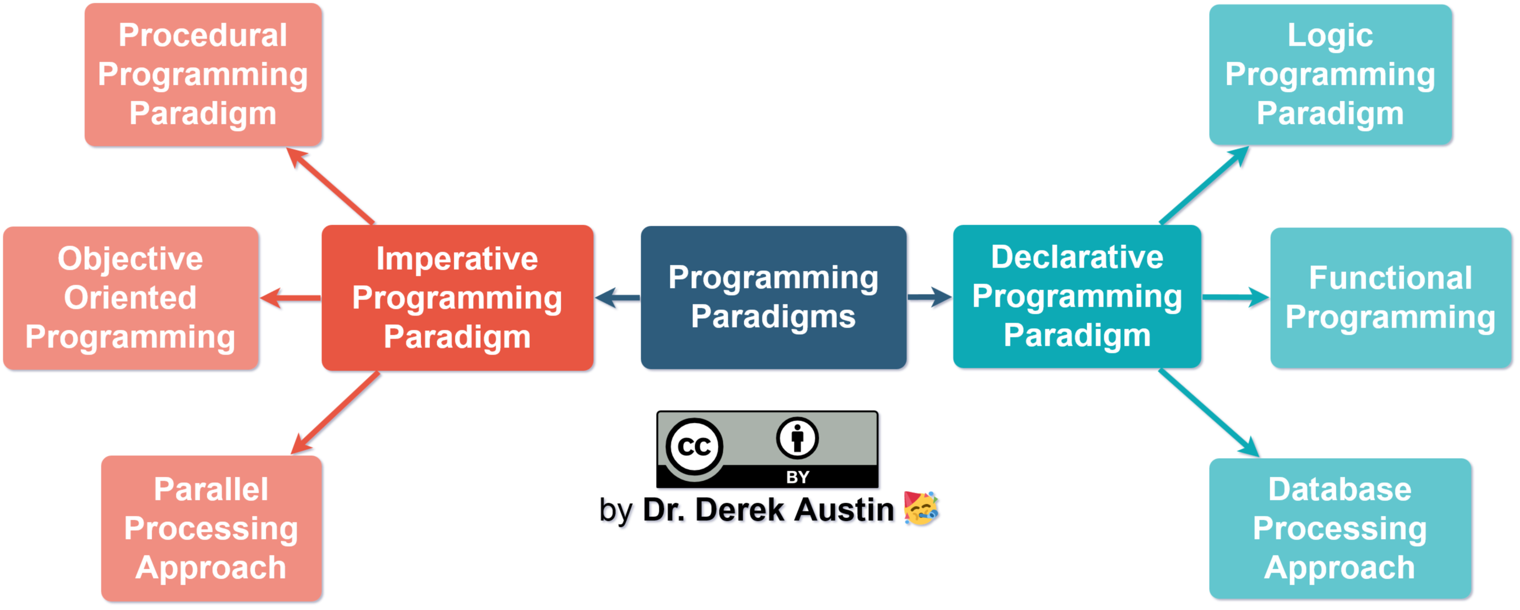
Programming paradigm

Slide 6
Functions vs Procedure
Functions may act more like procedures
a procedure is another unit of modularity
the idea behind a procedure is to accomplish one or more related activities
the activities should make up some logical goal of the program but may not necessarily be based on producing a single result
procedures may return 0 items or multiple items unlike functions
In languages like C, there are no procedures, so functions must take on multiple roles
mathematical types of functions
functions that act as procedures
Such functions can produce side effects
mathematical functions do not produce side effects

Slide 7
Example
// function def square( n ): return n * n; | // procedure def display(n): print( "The value is:" + n );

Slide 8
Why functional programming?
Mathematical approach for problem solving
Simple and less abstract
Characteristics
Reuse
Test
Handle concurrency

Slide 9
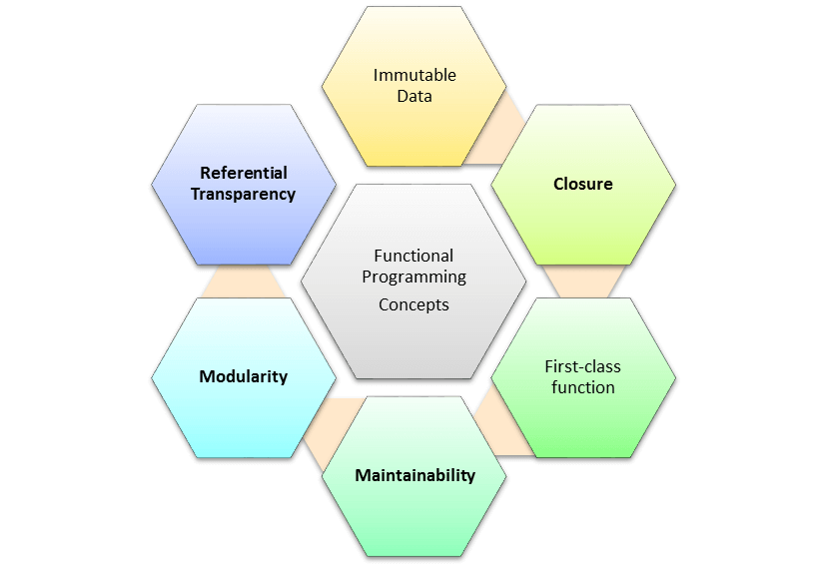

Slide 10
Immutable Data
Immutable Data implies that you ought to effectively ready to create data structures as opposed to altering ones which is now exist.
Example:
employee={
‘name’: ‘Ahmed’,
‘salary’: 6000,
}
updated_ employee={
‘name’: ‘Ahmed’,
‘salary’: 8000,
}

Slide 11
Referential transparency
Referential transparency is the ability to replace a function call with its return value, the behavior of the program would be as predictable as before.
Example:
def two():
return 2;
four = two() + two(); // 4
// or
four = two() + 2; // 4
// or
four = 2 + two(); // 4

Slide 12
First-class function
‘First-class function’ is a definition, attributed to programming language elements that have no limitation on their use. Hence, first-class functions can show up anyplace in the program.
Example:
def say_hello(name):
return(f'Hello {name}')
Say_hello_2 = say_hello
print(Say_hello_2('Ahmed’)) // output: Hello Ahmed

Slide 13
Closure
The closure is an inner function which can access variables of parent function’s, even after the parent function has executed.
Example: def create_counter(): count=0 def get_count(): return count def increment(): nonlocal count count+=1 return (get_count, increment) | get_count, increment= creater_printer() print(get_count()) Increment() Increment() print(get_count()) Increment() Increment() Increment() print(get_count()) | Ourput: 0 2 5

Slide 14
FP Concepts
Modularity design builds usefulness. small modules can be coded rapidly and have a greater chance of re-use which without a doubt leads quicker development of projects. Aside from it, the modules can be tried separately which assists you with reduce the time spent on unit testing and debugging.
Maintainability is a simple term which means FP programming is easier to maintain as you don’t need to worry about accidentally changing anything outside the given function.

Slide 15
Principles of Functional Programming
Purity
Acts on their parameters only, produce same result, no side effect
High order
A concept of first-class-citizen of the language, can take values or functions as parameters or return another functions
Composition
One function become a result of another functions, e.g., func = f(g(x))
Currying
Takes only one/single parameter at a time e.g., f(x)

Slide 16
Pure functions
A pure function is a function which:
Given the same inputs, always returns the same output
Has no side-effects
Example:
//pure function
def sum(a, b):
return a + b
//non-pure function
b =0
def sum(a):
return a + b

Slide 17
Recursion in FP
Break down a problem into smaller pieces.
Benefit: helps us eliminate the side effects, which is typical of any imperative style looping.
Example:
def count_down(x):
if x<0:
print(‘Done!’)
return
print(x)
count_down(x-1)

Slide 18
Advantages of FP over other programming paradigm
High level – describing the result rather than step to get there. This single statement is preferable
Transparent – behavior of FP depends only on the input, eliminating side effects
Parallelizable – functions that have no side effects runs easily in parallel

Slide 19
Limitations of FP
Not easy for beginner
Hard to maintain as many objects evolve during coding
Reuse is complicated
Objects may not represent the problem correctly

Slide 20
Example program
Imagine that you want to find the sum of a sequence of numbers. In an imperative language like Java:
public int sum(int[] numbers) {
int accumulator = 0;
for (int n: numbers)
accumulator += n;
return accumulator;
}
Is the program functional programming type?
Discuss according to mutable state.

Slide 21
Summary
FP is way of thinking on software development based on functional perspective
FP focus on results rather than process
FP is mimicking the mathematical function but not necessarily construct mathematical representation in the program
Prominent programming languages for FP: Haskell, Clojure, Scala, Erlang
Pure function depends on input and output
FP uses immutable data, OOP uses mutable data

Slide 22

Thank You
Next: Functional Parallelism and Concurrency

